Slide 1
STEM education through research and AZSEF Regional fair system.
By Dr. Paul McElligott
Fountain Hills High School
Fountain Hills, Arizona

Slide 2
Arizona Science and Engineering Fair
Phillip Huebner, Director
Arizona Science and Engineering Fair (AzSEF)
Arizona Technology Council Foundation

Slide 3
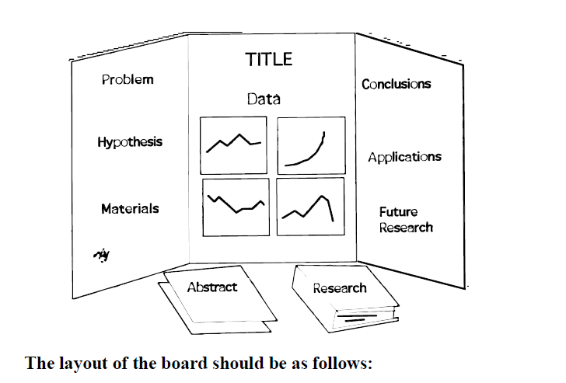
Arizona Science and Engineering Fair
Phillip Huebner, Director
Arizona Science and Engineering Fair (AzSEF)
Arizona Technology Council Foundation
One Renaissance Square, 2 N. Central Ave.
Phoenix, AZ 85004
Phone 602.770.7577
Fax 602.343.8330
phuebner@aztechcouncil.org

Slide 4
STEM
Science
Technology
Engineering
Math

Slide 5
STEM
Where is the largest deficit of ability in most students?
Science
Technology
Engineering
Math

Slide 6
STEM
Where is the largest deficit of ability in most students?
Science
Technology
Engineering
Math

Slide 7
STEM
Fountain Hills battles math by doing Physics First using the ASU Modeling Course.
Excellent on Graphing.

Slide 8
STEM
Despite capabilities, students can be encouraged to accelerate their learning when it is relevant!
So….
How do we keep students focused and motivated?

Slide 9
Need For Relevancy
Teacher Concerns
How do I gain the skills to challenge students?
I hear “When will I ever need this stuff?”
How can I knock my students off dead center and force them to ask questions?
Teacher Observations
Students lack drive
Students only do enough to satisfy parents or to graduate
Students lack curiosity

Slide 10
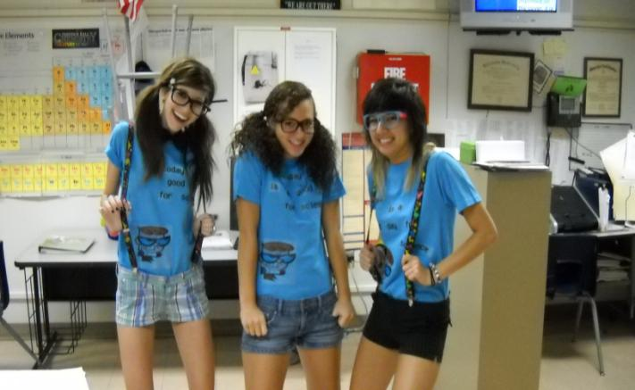
Each student has an individual learning style!

Slide 11
So What Motivates Students to Learn?

Slide 12
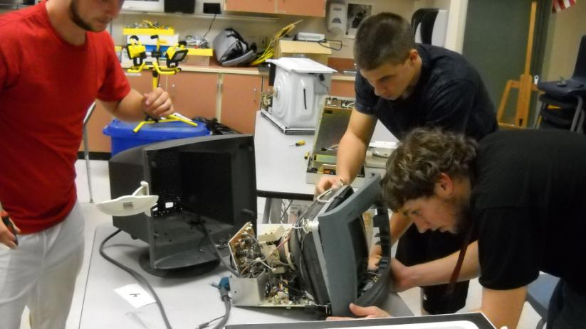
Students want to tear things apart!

Slide 13
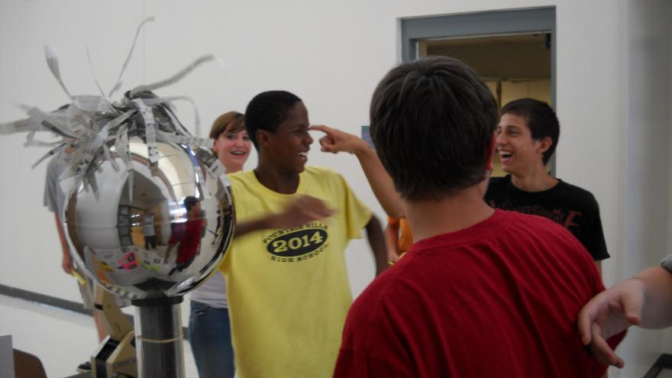
Students need to experience to believe!

Slide 14

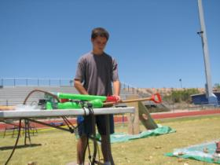
Students want to win!
Most potatoes launched in three minutes: Garrett Sweetland sets world record
Fountain Hills, AZ, USA -- Garrett Sweetland, 15, a freshman at Fountain Hills High School, used an air gun he built to launch 17 potatoes through the tennis racket target on the school's football field - setting the new world record for Most potatoes launched in three minutes

Slide 15
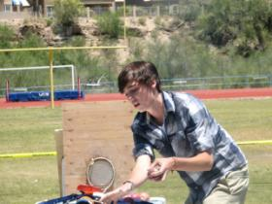
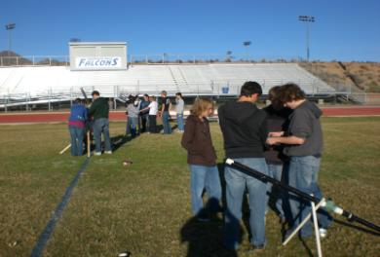
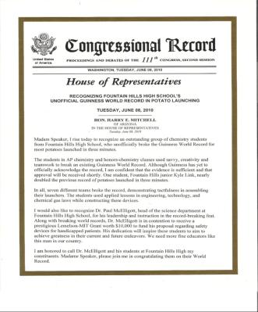
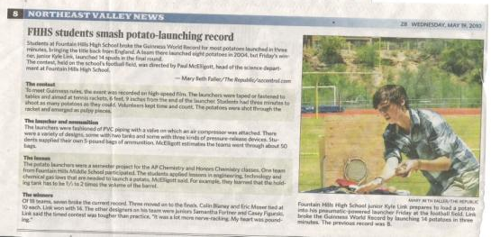
Students need recognition!

Slide 16
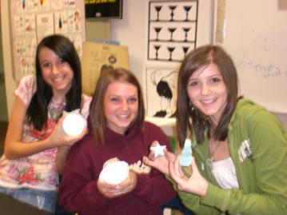
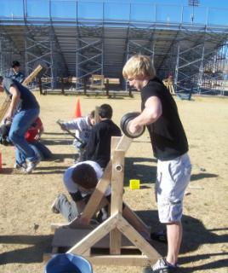
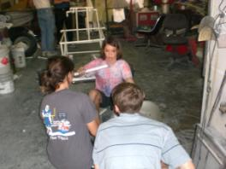
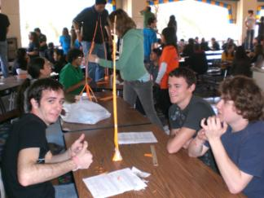
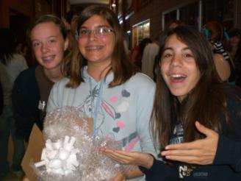
Students want to have fun!

Slide 17
Classroom Learning Approaches

Slide 18
Project Based Learning (PBL)
Learning Surrounding a Central Project

Slide 19
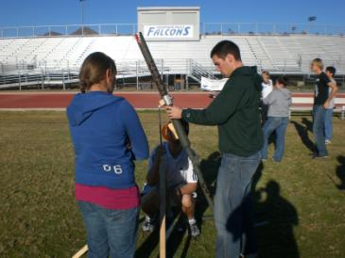
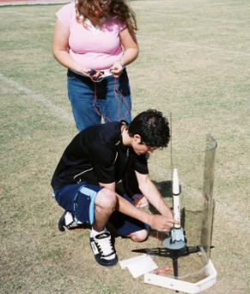
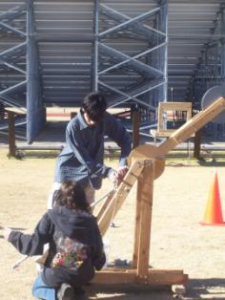
PBL – Rockets, Canons & Catapults

Slide 20
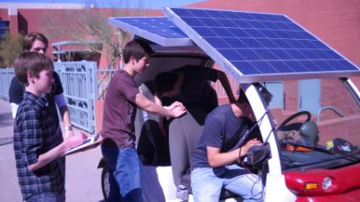
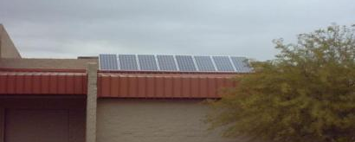
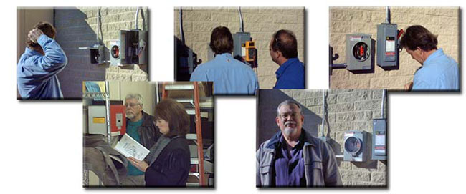
PBL – Photovoltaics

Slide 21
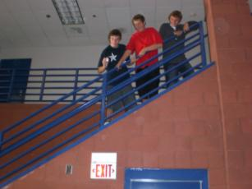
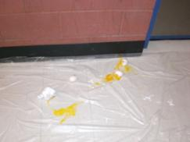

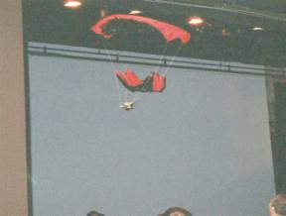
PBL – Classroom Competitions
Egg Drop Competition
Parachute Drop

Slide 22
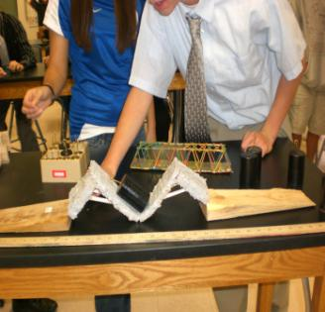
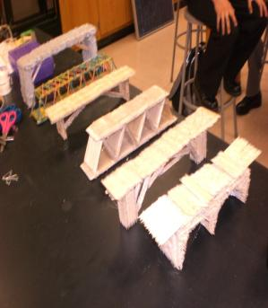
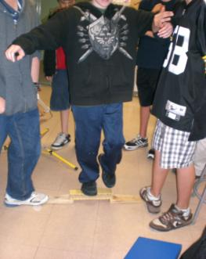
PBL – Design & Building
Strongest
Toothpick Bridge

Slide 23
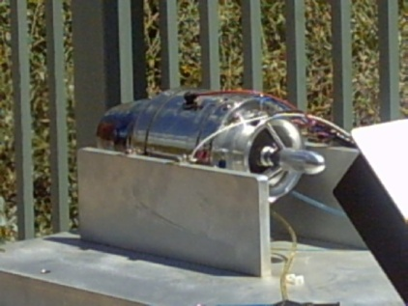
PBL – Turbine Experimentation

Slide 24
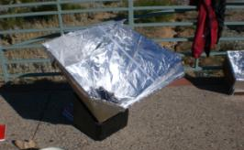
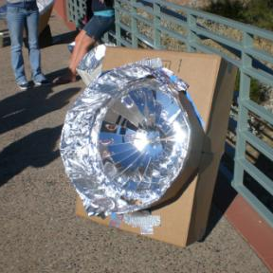
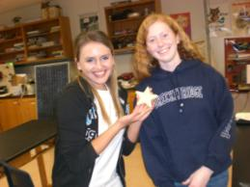
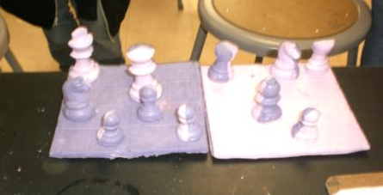
PBL – Classroom Projects
Solar Ovens
Artistic Soap Making

Slide 25

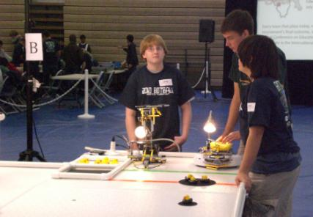
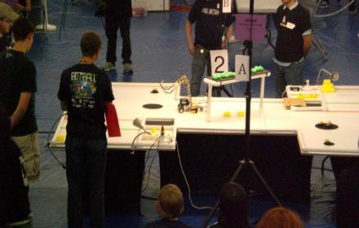
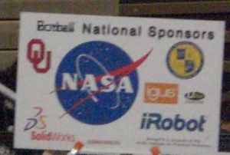
PBL - Robotics

Slide 26
Students Need Competition

Slide 27
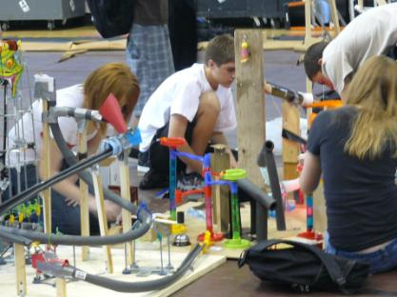

World Record Attempts
Rube Goldberg
Longest “Alarm Clock”
Most Potatoes Launched
In Three Minutes

Slide 28
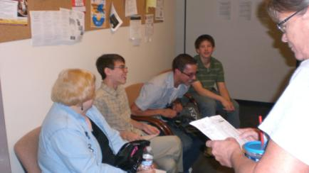
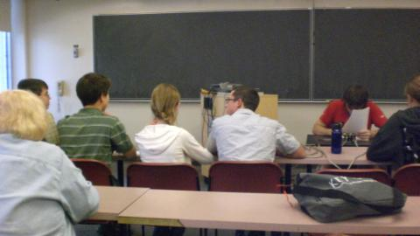
Quiz Bowl - ASU

Slide 29
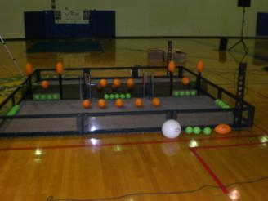
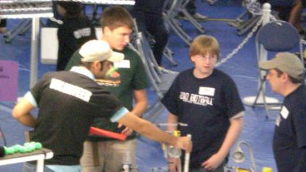
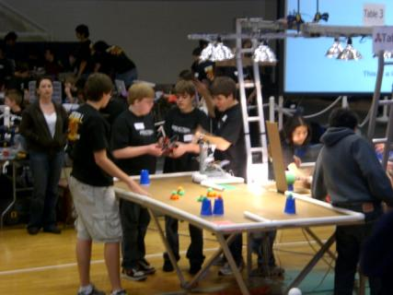
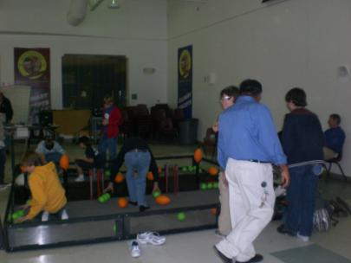
Robotics – VEX, Botball

Slide 30
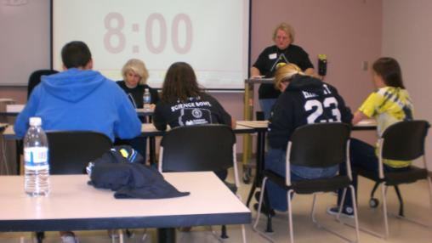
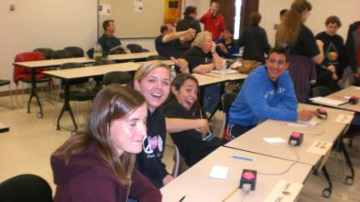
AZ Science Bowl

Slide 31
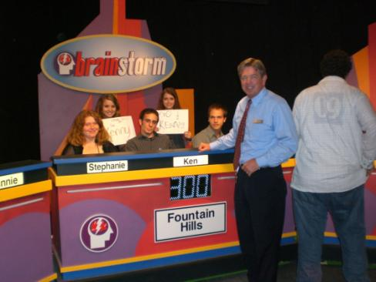
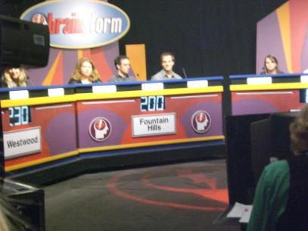
BrainStorm – Channel 7

Slide 32
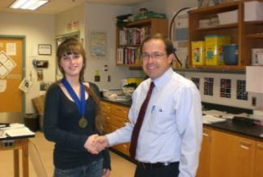
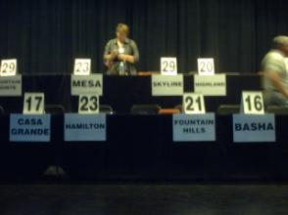
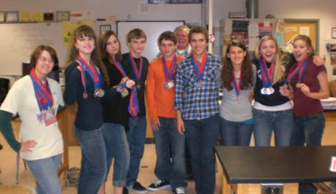
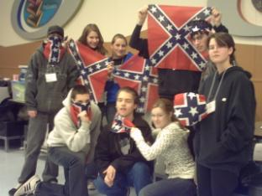
Academic Decathlon

Slide 33
Target Your Talented Students Toward Grant-Based Projects

Slide 34
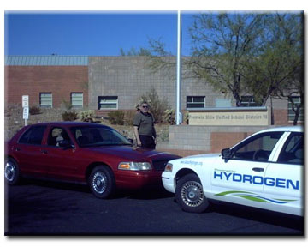



Hydrogen/Methane
Research Vehicles

Slide 35



X-Prize Automotive Competition

Slide 36



Alternative Fuel Research

Slide 37



Campus Solar Lighting Project

Slide 38



Solar Observatory

Slide 39


Solar Golf Cart
Silver medal winner at AZSEF

Slide 40
Activities at Fountain Hills High School last Semester
Solar Observatory
Vex Robotics – Tucson and FHHS
Botball Robotics – San Diego
SCC Math and Science Field Day
Academic Decathlon
Car Show on High School Campus
Regional AZSEF Competition - FHHS
Guinness World Record

Slide 41
Teachers
Be Pro-Active
Enter student competitions
Write grant proposals (Better yet…have the students write them)
Go to national meetings and expand your horizons
Apply for fellowships or find opportunities to do research with university professors
Compete for national training
Involve your students in research
Utilize community experts and specialists as mentors
Promote your programs – toot your own horn!

Slide 42
AZ Science & Engineering Fair
Focus students into a project that has potential payoff
Support students with after school and weekend experimentation time.
Develop a solid research plan.
Do Bi-weekly check of their progress.
Have students divide the work according to interest and ability.
Keep them on task. – Encourage them to solve their own problems.
What if the research does not work?
Instruct students on how to write a solid paper.

